Slide 1
Achieving excellence – your tourism awards toolkit 2025/26
Peak District, Derbyshire & Derby Tourism Awards
© VisitEngland/ DanielaLuquini

Slide 2
What we will cover
Why do businesses enter the awards?
The tourism awards process
Your application
What are your next steps?

Slide 3
Why do businesses enter the awards?
Notes:
First off, why do businesses like you enter?

Slide 4
Excellence makes business sense
Customers will pay more for excellence
Recruit and retain better staff
Profile and pride
Profit!
Notes:
The awards are part of a journey which is about being the best you can be.
Simply by entering, you will enjoy a great number of benefits.
Everyone likes to win – but whether or not you achieve an award on the ‘night’, your business will be better as a result of taking part.
By applying, you will be turning a spotlight on your operation and shown how to look at it from the customer perspective.
By comparing yourself with your competitor set (those businesses operating in the same field), you will challenge yourself to be better.
At the end of the process, you will be well on your way to achieving excellence and this will have a positive impact on your bottom line.
Customers will happily pay a premium for a better experience, staff will be more motivated, settled and committed, your team will have a shared sense of pride and purpose and you will all be working towards a common set of goals.

Slide 5
Celebrating local excellence
Credits Matthew Jones Photography
Notes:
Some of our Gold winners from 2024/25
The Blind Bull, Pub of the Year – also shortlisted in the national Visit England Awards for Excellence
The Cavendish Hotel, Taste of the Peak District, Derbyshire & Derby Award - also shortlisted in the national Visit England Awards for Excellence
Thornbridge Hall, Visitor Attraction of the Year
3Trees Glamping, New Tourism Business of the Year
Pub Tours Ltd, Experience of the Year – previously won silver in 2023/24
All our Gold winners

Slide 6
Why did you enter your local tourism awards competition in 2024? – top 5 reasons
Applicant Survey 2024 – Why did you enter or consider entering your local tourism awards competition in 2024? N=175
Notes:
VisitEngland carries out an application survey with all entrants each year, which provides insight into why businesses entered.
Applicants entered their local competition for a number of different reasons and you may be surprised that winning an award is not the main reason!

Slide 7
Why did you enter your local tourism awards competition in 2023? – top 5 reasons
Notes:
In addition, in 2025, national winners from 2023 and 2024 were also surveyed as to the benefits of winning.

Slide 8
Why did you enter your local tourism awards competition in 2024? – other reasons
Applicant Survey 2024 – Why did you enter or consider entering your local tourism awards competition in 2024? N=175

Slide 9
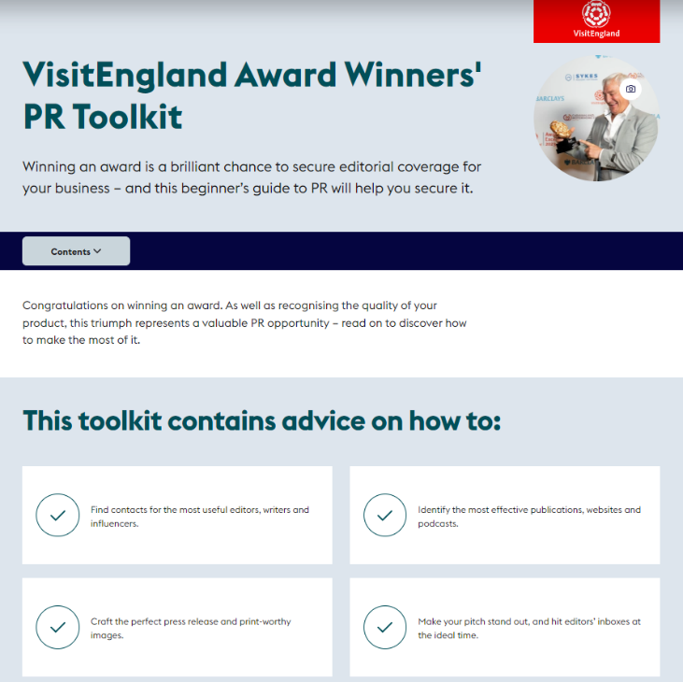
Benefits of entering
Receive a marque of quality assurance for use in marketing
Increase your media coverage and PR opportunities
Gain a competitive edge
Chance to compete regionally and nationally
Get free independent feedback
Review your approach to excellence and drive best practice
Network and celebrate with other businesses
Recognition and/or influence with local partners
Reward and motivate your team
Find out more about why you should enter:
visitbritain.org/business-advice/visitengland-awards-excellence
visitbritain.org/business-advice/visitengland-awards-excellence#pr-toolkit
Notes:
Over half of entrants said they entered to be able to provide a marque of quality assurance. This official endorsement and trusted logo gives potential customers another reason to book.
Becoming a finalist and then going on to win an award is a newsworthy story. It provides a great opportunity to generate media interest both locally in our awards and, if you go further, getting (regional and) national coverage. National winners have the additional benefit of being promoted through VisitEngland’s consumer communication channels.
VisitEngland has produced a comprehensive toolkit to help winners with their PR and you can see the link at the bottom. We will be sharing these links with you after today.
Winning helps you to stand out from your competitors and being an award winner provides you with a unique selling point to promote. This applies both to potential guests and visitors as well as prospective new employees – past winners have seen recruitment benefits as well as an increase in bookings / new business
Core category winners in local competitions are automatically put forward to the national VisitEngland Awards for Excellence. So you can get a competitive advantage by being recognised by potential customers as not only being one of the best tourism businesses in (note - include your destination) but in the country!
All entrants will receive free feedback on their entry to help them improve in future. If you receive a visit you will also receive a report on this which will enable you to identify areas where improvements could be made and also find out where you excel.
Competing against businesses in your area can give you a benchmark and a tangible level of success to aim for. We have heard examples of those who have won bronze going to visit the gold winners to find out how they could improve.
The process of applying for an award is a useful business management exercise. It helps you step back, reflect on your business and identify areas for future development.
Winning gives a cause for celebration not only within your business but also by networking with other like minded people in your area at the awards ceremony. This can sometimes lead to new business partnerships. If you go further you can socialise with the best of the best from around the country at the prestigious VisitEngland Awards for Excellence event.
Being an award winner can help you attract high quality staff and increase staff motivation and loyalty. As well as engender a feeling of pride within those who work for you. It is also a great opportunity to reward your staff and recognise their contribution to the business.
You can find more details about why people apply via the link below https://www.visitbritain.org/business-advice/visitengland-awards-excellence#why-apply
However remember, you will benefit greatly from the process of applying regardless of the outcome.

Slide 10
The tourism awards process
Notes:
We are now going to go through the actual awards process.

Slide 11
Reaching the VisitEngland Awards for Excellence
Peak District, Derbyshire & Derby Tourism Awards
VisitEngland Awards for Excellence
Notes:
The annual awards cycle begins with a series of local competitions such as ours, then for core categories to the national VisitEngland Awards for Excellence.
(Do remember that this only applies to the core categories and NOT any local-only categories.)
We are able to forward the gold winner per category to the national competition.
What this means is that businesses only have to complete a single application and local winners of core categories are automatically put forward to the national competition.

Slide 12
The Core Categories
Accessible & Inclusive Tourism
B&B and Guesthouse of the Year
Camping, Glamping & Holiday Park of the Year
Experience of the Year
Hotel of the Year
New Tourism Business of the Year
Pub of the Year
Regenerative Tourism Award
Regenerative Tourism Award
Self Catering Accommodation of the Year
Taste of the Peak District, Derbyshire & Derby Award – Café/Tearoom
Taste of the Peak District, Derbyshire & Derby Award - Restaurant
Unsung Hero Award
Visitor Attraction of the Year
Notes:
This is the list of core categories as outlined by VisitEngland. Entrants are encouraged to enter as many as are appropriate to their business. Each has detailed eligibility requirements that are outlined at the start of the entry process, and a business will need to satisfy themselves that they meet these before entering. There will inevitably be a small number of grey areas, if you’re not certain that you meet a specific criteria, please do contact us and outline your query and we will be able to confirm for you.
Winners from these categories will also have the opportunity to represent our region at the national Awards that take place in June each year.

Slide 13
The Local Categories
Dog Friendly Tourism Business
Family Friendly Tourism Business
Festival or Event of the Year
Team of the Year
Tourism Young Achiever
Notes:
This is the list of local categories that we are also running within our region. They are all set up and accessed via the same online system that we’ll run though in a moment, but these winners do not go on to any national awards, they are recognised here within our region instead. We’ve carefully selected these areas for additional categories in particular based on the businesses and make up of our region; it gives a great opportunity to shine the light on some of the other fantastic tourism businesses that we have here.
As with core categories, each has a list of eligibility criteria that need to be met and I’d encourage you to read through those for any that you are considering applying for in the first instance. Again, if you’re unsure or have a particular question, you are very welcome to get in touch at any stage.

Slide 14
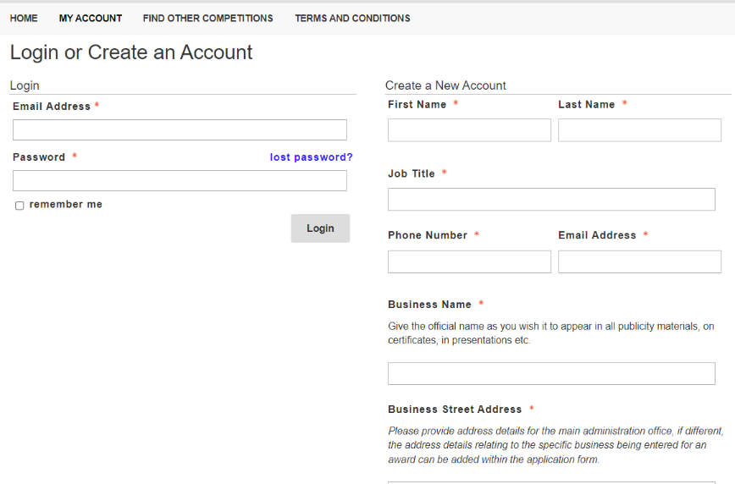
The application system
Find out more about the categories:
https://visitpeakdistrict.com/industry/events/category/tourism-awards
visitbritain.org/business-advice/visitengland-awards-excellence/visitengland-awards-excellence-award-categories
Notes:
We use an online system called OpenWater for the entry procedure. You don’t need to register just to access details about the awards. We have loads of information on the Industry website including access to download all the application forms, including the eligibility criteria, helpful hints and tips etc
However, to enter you will need to register and complete the application forms online. The link to Openwater in on the Awards page on the Industry website
The system is very user friendly and we will be on hand to help if you have any queries. You can save your entry as you go along and print it out, should you wish to share it with others, so you don’t need to do it all in one go.
There are some important things to note that will help you make full use of the system –
You will need to register to create a login, so that you can save and submit your application
You can delegate the application to a colleague if necessary, however do consider that all communication regarding progress of your entry and ultimately feedback from judges will all go to the email address used to submit your entry.
The system will strip out any formatting attached to data you cut and paste across from another source. If you are using cut and paste from a Word document, you will need to use Ctrl-V rather than the 'paste' option
Therefore, you must double check all formatting and especially URL links
Text boxes will cut-out at the word limit
Anything with an '*' is mandatory and the application will not submit until those fields are completed
You will not be able to access/amend applications once the deadline has passed
Double check that your application has been submitted and not marked as 'incomplete’
There is no limit to the number of entries that you can submit. (Note – state here whether it is free to enter or if there is a cost).
The core categories that link with the VisitEngland Awards for Excellence are set by the Tourism Awards Steering Group and are reviewed annually to reflect the latest industry structure and market trends.
As previously mentioned:
The core categories this year are:
B&B and Guest House of the Year
Camping, Glamping and Holiday Park of the Year
Experience of the Year
Hotel of the Year
New Tourism Business of the Year
Pub of the Year
Self Catering Accommodation of the Year
Taste of the Peak District, Derbyshire & Derby – Café/Tearoom
Taste of the Peak District, Derbyshire & Derby - Restaurant
Visitor Attraction of the Year
We also run these core categories:
Accessible and Inclusive Tourism Award
Regenerative Tourism Award
Unsung Hero Award
And these local schemes:
Dog Friendly Tourism Business
Family Friendly Tourism Business
Team of the Year
Tourism Young Achiever
If you are going to enter more than one category, don’t just cut and paste the same answers across all your entries, but ensure your answers are tailored to the relevant category. For example, if you run a small hotel with a restaurant and wanted to enter Small Hotel and Taste of the Year, you will need to provide different information for each entry, with one relating to the hotel side the other the food.
Remember to save everything as you go along and press submit before the deadline.
If you have any queries with using the system, contact us on 07711 302151

Slide 15
The Judging Process
Business Enters Awards
Eligibility & Round 1 Judging
Round 2 visits agreed
Visits take place
Winners are decided
Entrants advised if finalists
Entrants advised
Organisers confirm VE nominations
Feedback sent to every entrant
Local Awards Event
Entrants advised if finalists
VisitEngland Judging
VisitEngland Awards Event
Notes:
Let’s run through the process, starting top left …
Business submits their entry form on OpenWater
Round 1 judging takes place (including eligibility checks)
Businesses are/may be informed if they have shortlisted to round 2 judging or not
Round 2 judging takes place (visits for most categories)
Decide local winners
Finalists are informed that they have won something and are invited to Awards event
Awards event takes place where Gold, Silver and Bronze winners are announced
All businesses receive Round 1 or Round 2 feedback (some schemes offer more) – VisitEngland require the following as a minimum
Round 1- minimum of 3 ways to enhance their application
Round 2 – minimum of 3 main strengths and 3 areas for improvement
Regions nominate a specified number of finalists to VisitEngland
Businesses are informed if they have been shortlisted for the VisitEngland awards or not
VisitEngland judging – using the same judge data as used locally (from both rounds 1 and 2) as well as latest online presence research
VisitEngland Awards event – national winners will be revealed

Slide 16
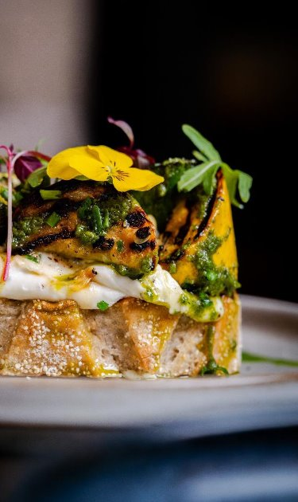
Top tips 1
Read the guidance
Choose categories
Check your eligibility
Read through the questions
The Peterville Inn, Cornwall © Frankie Thomas Photography/The Peterville Inn Pub of the Year, Gold, 2024
Notes:
Our website and VisitEngland’s website have loads of information to help you, so make sure you read it through before you start.
Then select the category you want to apply for and read the eligibility criteria at the start of the entry form to ensure you are entering the right category. If you are unsure, please contact us at this stage.
For all entries you must be "Directly involved in tourism, making a contribution to the visitor economy with a significant proportion of business generated by people visiting from outside the local area“.
Note - below is the tourism product definition - which is the other key decider for the sector-wide categories which you might wish to go through or just use if there are any questions.
Meets the tourism product definition:
Only tourism businesses who directly serve the end-users (i.e. the tourist/ visitor/ guest) and who control the visitor experience are eligible.
Applicants that operate multiple sites (e.g. chains, self catering agencies) are invited to submit applications that relate to only one site (up to a maximum of 3 separate applications per category).
Any award must then be associated with this one property or location, and not the agency/ chain as whole.
This includes a number of different types of business:
Accommodation e.g. hotels, bed & breakfasts, guest houses, self-catering/serviced apartments, hostels, holiday boats, camping, caravanning, glamping, lodges, shepherd’s huts, chalets
Hospitality i.e. a single food and beverage service business e.g. pub, restaurant, café, tea room, coffee shop, bistros, food and drink markets, kiosks & street food (in a regular location). [For these purposes the definition of a food and drink market is a collection of independent food and drink establishments with ancillary services (e.g. parking area, toilets, security, visitor information) and maintained by a management firm as an entity.]
Transport services e.g. rail, road, water, airports and rental
Guided tours
Cultural services, e.g. theatres, musical entertainment venues, sporting venues
Business events venues
Sporting, adventure and recreational activities
Retail i.e. a single retail outlet or shopping centre that attracts a significant number of people visiting from outside the local area [For these purposes the definition of a shopping centre is a collection of independent retail stores with ancillary services (e.g. parking area, toilets, security, visitor information) and maintained by a management firm as an entity.]
Businesses providing supporting services to visitors in-person within the destination e.g. visitor information providers, left luggage services
Visitor attractions that meet the visitor attraction definition: a permanently established excursion destination, a primary purpose of which is to allow access for entertainment, interest, or education and can include places of worship; rather than being primarily a retail outlet or a venue for sporting, theatrical, or film performances. It must be open to the public, with or without prior booking, for published periods each year, and should be capable of attracting day visitors or tourists as well as local residents.
Before you start, have a read through the form to ensure you have a good understanding of what is required for each question.
Check the eligibility criteria carefully before starting your entry, if there’s any doubt about which categories are best suited to your business, please ask.

Slide 17
Your application
Notes:
Our next section is going to go through the detail of the actual entry form for this year’s competition.

Slide 18
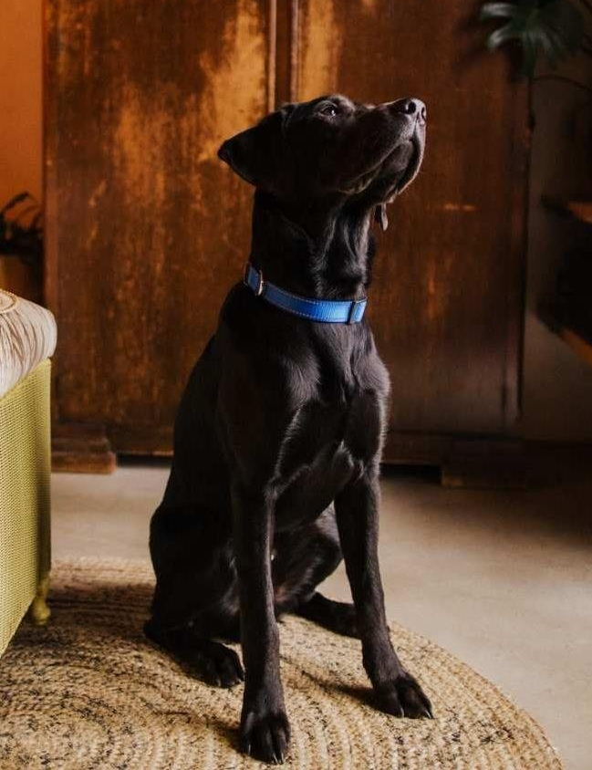
Setting the scene
Business details
Promotional description
Promotional images
Background
Awards and accolades
VE/AA rating
Do you have any other quality awards/ratings?
Bethnal&Bec, Hertfordshire © Bethnal&Bec Self Catering Accommodation of the Year, Bronze, 2024
Notes:
The start of the entry form is not scored. It gives you an opportunity to provide background information for the judges.
Please use the business name as you wish it to appear in all publicity materials, certificates, presentations etc, should you be a winner.
You need to provide a 120 word promotional description of your business, focusing on its strengths and stand out features, relevant to the category you are entering. Do take a bit of time crafting your words, as they will be used in PR and awards literature if you are short-listed as a finalist.
The same goes for the images, so please make sure that you use high resolution photos (jpeg, jpg, png format) that showcase your business, again relating to the category you are entering. You can have up to three. They should not be edited in any way, including embedded text, logos or a collage. Importantly, make sure that you only include photos that you own the copyright for. If it requires a third party credit such as photographer name, there is a box for you to include their details. It’s important to select your images carefully – these will be used for PR, social media etc locally / regionally, potentially these images will be used by VisitEngland if you are successful and so could be your national promotional material, make sure they’re inspirational and your best advert.
You then have 250 words to briefly outline the story of your business, e.g.:
Length of time business has been trading and time under current ownership
Target market(s) and typical customer profile
Key milestones in developing the business
Indication of size of business
Number of staff employed, if any
The final element in this section is to look at awards, ratings and accolades that you have received in the last two years. You should include the title, awarding body, level and date achieved. They could include:
Successes in this competition and the VisitEngland Awards for Excellence
TripAdvisor Certificate of Excellence
Green Tourism award
Chamber of Commerce or other industry body awards
Local awards
Specialist awards
Customer service awards
VisitEngland and/or AA quality assessment, local quality accreditation
For specific categories like the Accessible & Inclusive Tourism Award, there may be other relevant awards e.g.:
Accessibility certification e.g. National Accessible Scheme, Autism Friendly Award
Disability Confident employer scheme
Annual awards for accessibility
There is no requirement for your business to be quality assessed. However, if you have independent quality assessments or mystery shopping reports from the last two years, you can upload them if you wish.

Slide 19
Supporting evidence
Relevant links
Evidence that supports the question
Adds value, does not repeat
Wildhive Callow Hall, Derbyshire © Adam Lynk/Wildhive Callow Hall Small Hotel of the Year, Silver, 2024
Notes:
For each question you have the option to provide evidence to back up what you have said in your answer. This is not compulsory.
You might want to include links to your pages on your website that include information relevant to the section you are answering.
Judges will do a thorough review of your online presence and will surface most content, so if you are providing additional information over and above what is publicly available, make sure it genuinely adds an extra dimension to your answer. It is therefore not generally necessary to link to public pages on your website, or provide additional photos, unless illustrating something specific from within the application that can't be found elsewhere online.
If you want to show the judges any ‘behind the scenes’ information or data that is relevant to your application, you can include links to ‘hidden’ pages on your website that are not viewable by the public. Any individual supporting documents will need to be placed in a cloud folder (one drive/ google/ dropbox etc) and the URL for that added to your entry rather than individual documents.
It’s not possible to add individual supporting documents directly to your entry.
Any written information provided in supplementary evidence in an attempt to get around the word count limit will be disregarded.

Slide 20
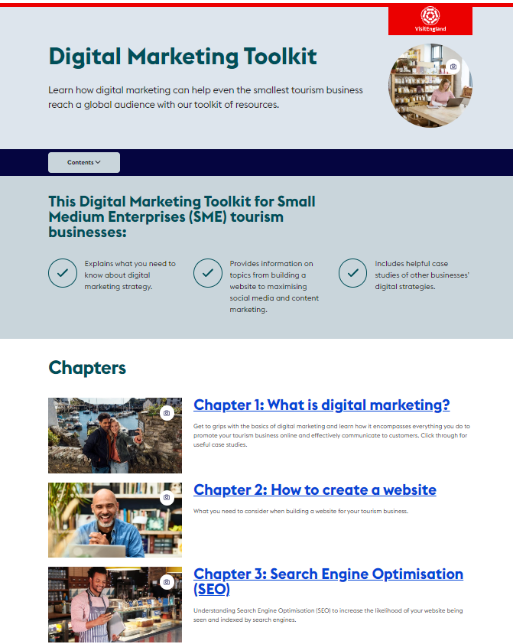
Importance of online presence & reviews
Provide relevant links
Review sites
Website
Social media platforms
Regenerative Tourism policy/ information
Accessibility guide/ information
Booking/ distribution platforms (International Tourism Award only)
Evidence of engagement
Find out more about online marketing:
www.visitengland.org/onlinemarketing
Notes:
We now move on to the scored sections.
You need to provide links here to your online presence in relation to the category you are entering e.g.:
Links to any business pages/profiles on Facebook, Instagram, etc. and X (formerly Twitter), LinkedIn, Tik Tok handles
Provide specific links to customer review listings for your business e.g. TripAdvisor, Booking.com, Facebook, Google, Euan’s Guide, UpFront Reviews etc.
For the International Tourism Award, they will also be looking at booking and distribution platforms.
As part of this review, judges will be looking for evidence of your commitment to Accessible and Inclusive Tourism and Regenerative Tourism.
NEW for 2025/26 – if applicants don’t have appropriate links, but are delivering in the areas of accessibility and inclusion, regenerative tourism and booking/ distribution platforms, there is an option to include 300 words to describe the business’ approach if the details are not available online.
Other sites not listed in your entry will also be looked at, so you can't hide bad reviews or lack of engagement etc.
If you go through to the VisitEngland Awards for Excellence, this section will be revisited by the national judges. So make sure that all your digital platforms are up to date before you submit your entry and are maintained throughout the year, as the national judging is likely to take place in March 2026.
As we said at the beginning that these awards are all about excellence, so the judges will be looking at how you excel in this area and how you engage with your target markets.
VisitEngland has produced a Digital Marketing Toolkit which is well worth a read to see how you could improve your online presence available via - www.visitengland.org/onlinemarketing.
There is loads of information available that can help you to make best use of social media, manage your website, produce great content and use Google to your advantage.
The top tips from the toolkit are:
Tag images with Alt-text to improve search-ability and site accessibility
Use free Google My Business posts to promote new products or seasonal offers
Link AdWords to your Google Analytics account to make campaigns easier to track
Use Facebook ads to target users by location, interests and even purchase history.
Note – you may wish to use your own examples here for best practice i.e.
How you are reassuring/encouraging visitors and showing how you are providing a safe, welcoming place to visit
Ensuring that your website is fully accessible and responsive
How you are engaging with visitors: are you posting regularly with interesting content and film, do you promote special offers, are you making best use of the platforms (e.g. booking through Facebook), sharing user generated content, having conversations with potential visitors, generally being sociable?
How are you responding to reviews?
Are they personalised, do you show how you are acting on feedback, are you using them as an opportunity to encourage repeat visits?
How do deal with a negative review? A good format for response is often:
Acknowledge
Defuse
Detail
Resolve
Further information from Round 1 Judging Matrix:
What excellent online presence looks like . . .
Business & Destination Inspiration:
After reviewing the business’s online presence, you are inspired to visit.
• Creative and inspirational content
• Great tone of voice, sense of place
• Professional, high quality, inspirational and diverse imagery – e.g. photos, videos, 360 tours
• High levels of engagement – e.g. more engaging content such as podcasts, vlogs, blogs, webcams, links to destination organisations for destination inspiration; respond to/ act on user generated content; interactive online activities
• Creative use of platform functionality – e.g. online booking, events information/ what’s on listings
• Reaching wider audiences – e.g. use of Weibo to attract Chinese visitors; develop activity on TikTok to attract a different audience demographic
Information (all categories):
• User-friendly (mobile responsive, easily found via SEO), intuitive navigation
• Up-to-date – e.g. live updates, announcements, closures, special offers
• General Content – e.g. availability, opening times, secure booking, prices, parking, facilities, things to do, menus, events, contact info (address, phone, e-mail, social media, live chat), T&Cs, policies
• Location Content – e.g. interactive maps (google), directions (road, public transport, cycle routes), parking
• Enhanced Content – e.g. interactive site/ orientation maps, translation, itineraries, local weather, local traffic, destination information, user generated content
• Accessibility – e.g. online content (accessibility guide, captions, colour contrast, font type and size), accessibility of business itself
• Sustainability – e.g. policy, discounts for using public transport
Chain/ group websites:
• Information available via generic/ central website combined with more local/bespoke site specific information via social media
(e.g. local sites may have limited influence over the parent company website), however the focus should be on visitor experience and if the site-specific information is lacking, the score should reflect this, even though the local team may not be able to control this. However, if steps are being taken at a local level to supplement the website information with bespoke local information via social channels (for example) this could enhance the overall offering to achieve a better score. However, if both the website and the social media does not offer the level of local detail expected, then the score should reflect this.
Accessible & Inclusive Tourism Award:
• Accessibility information with link to AccessAble Detailed Access Guide
• Clear font, with no text over imagery
• Videos have captions/sub-titles
• Accessibility is clearly a core aspect of online strategy
• Interesting and inspirational accessibility related activity/ updates
• Imagery features disabled people
• Website accessibility statement
• For more examples of best practice, visit the Accessible and Inclusive Tourism Toolkit for Businesses
International Tourism Award:
• Evidence of being open all year round
• Using booking and distribution platforms to promote business to international visitors, with a clear and easy process for online booking (e.g. without additional steps to complete the booking)
• Evidence of some information translated for specific markets, where relevant
• Evidence of partnerships with other local tourism businesses and destination inspiration with links to book
• For more example of best practice, visit the Taking England to the World toolkit

Slide 21
The four key questions
Your top qualities
Your recent improvements
Your results
Your future plans
Notes:
Our next section is going to go through the detail of the four main questions for most of the categories.
NB – the only exception here is the Unsung Hero Award, Team of the Year and Tourism Young Achiever which only have one main nomination.

Slide 22
Question 1: Your Top Qualities
Unique selling points, strengths and essence of your business:
Quality of your core product and customer experience
Added extras that delight your customers
How you care for your team
Use and promotion of local suppliers
Innovative marketing and PR
Inclusive facilities, experience & welcome
Sustainable practices that align to regenerative tourism
Innovative adaption, diversification and/ or resilience building
The Gallivant, East Sussex © The Gallivant Small Hotel of the Year, Gold, 2024
Notes:
Remember that the local competition is the start of a journey that could end in being the best in the country - so think about not only what makes you the best in your area, but potentially the best of the best across England.
Think about:
why your business is impressive compared to your competitors
do your customers say you are the best? What is the most frequent comment they make about you?
why the experience you offer is so memorable..
Consider all areas of your business that you excel in e.g. services and facilities offered, care that you give to your staff and visitors, sustainability, accessibility; think about the ways that you are innovative in your field.
Review the bullet points under each question when answering, they include lots of different areas you might want to consider (and those that judges will be keen to see!)
What do you do to ensure every element of your business is excellent?
We’ll have a look at a few of these areas in a bit more detail in the next few slides

Slide 23
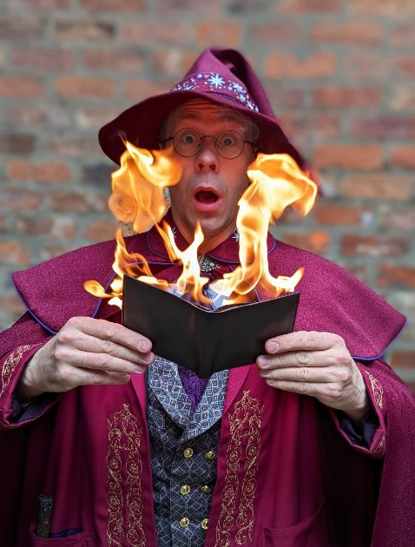
Areas to Consider for Q1
Caring for your customers
Always going the extra mile
Staff training and development e.g. Welcome to Excellence/In-House training
Induction process for new staff
Customer feedback initiatives/complaints process
Attention to detail
The Wizard Walk of York, North Yorkshire © Hunter-Howard Photography/ The Wizard Walk of York New Tourism Business of the Year, Gold, 2024
Notes:
How do you delight every single customer that comes through your door?
How do you make them feel special and provide them with amazing memories to take away?
What added value do you offer your guests? This could be things like the warmth of welcome from you/your team, or the follow up you give.
How do you ensure that your staff are the best ambassadors for your business - is this through recruitment, induction, training, reward?
Why will guests shout about you to all their friends?
If there is a problem, is it dealt with swiftly and how is it acted on?
Who is responsible for ensuring that every aspect of a visit is perfect?

Slide 24
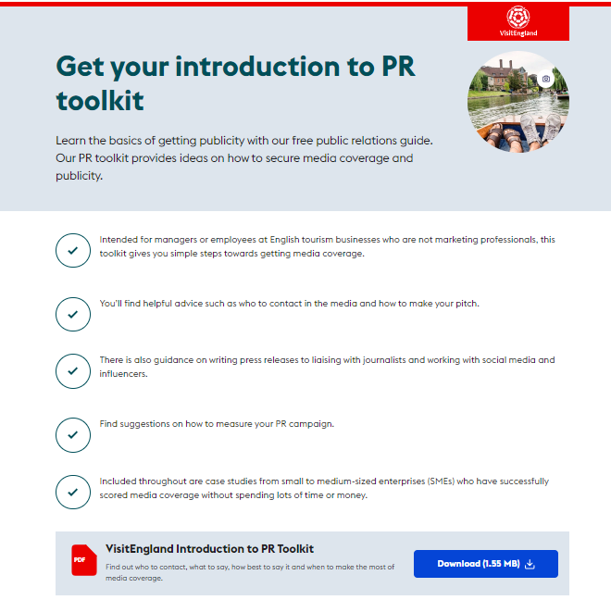
Areas to Consider for Q1
Innovative marketing /promotion
Specific marketing and promotion carried out?
Trying something different or out of the ordinary?
Social networking sites
Joint marketing with other tourism businesses
Engaging with LVEP, DMO and VE/VB campaigns
VisitBritain
Notes:
Some elements of marketing are ‘baseline’ that every business should be undertaking. You need to show things you are doing that are out of the ordinary.
It is important to show the full ‘journey’ of the marketing activity -
How did you identify the need/opportunity (customer feedback perhaps?)
How did you use this to influence what you did?
How did you monitor the effectiveness of the activity and amend as/if needed? (e.g. change in comments on customer review sites?)
How did you ensure the activity was integrated across all platforms, including social media?
How did you increase reach and impact by working with other businesses and local organisations (including your LVEP/DMO?)
What was the impact of the activity on your business/bottom line (be as specific as possible)

Slide 25
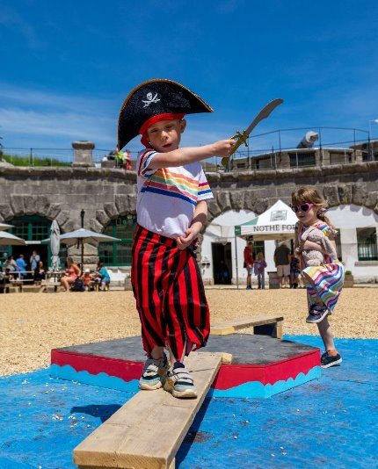
Areas to Consider for Q1
Inclusive facilities, experience and welcome
How you attract a diverse audience
How you provide for visitors with access needs
What you have in place to ensure all visitors are welcomed, supported and encouraged to take part or enjoy their stay with you
Find out more about accessibility:
www.visitbritain.org/business-advice/make-your-business-accessible-and-inclusive/visitengland-accessible-and-inclusive
Visit England’s Accessible & Inclusive Tourism Toolkit (inc. Top 20 Tips)
www.visitengland.org/access
Webinar on accessibility
www.visitbritain.org/business-advice/business-recovery-webinars
Nothe Fort, Dorset © Paul Brewer Photography/NotheFort Small Visitor Attraction of the Year, Gold, 2024
Notes:
It is so important to stress that this aspect is part of what judges are looking for in ALL categories, not just the Accessible & Inclusive Tourism Award.
It also makes business sense, as nearly one in four people in the UK have an impairment, which may affect where they choose to stay or visit.
Improving your accessibility benefits all customers and does not always require major or expensive changes – simply providing a free Accessibility Guide for your venue can help you be more inclusive for people with a wide range of visible and hidden impairments.
Tourism businesses with improved accessibility appeal to a wider range of customers. It’s not just disabled customers who benefit; it’s families, older people and practically all of your customers in one way or another. People with health conditions and impairments tend to take longer holiday breaks than average and therefore tend to spend more money per trip. They also want more information in advance, which is why your accessibility information should be easy to find on your website.
As in other areas, the initiatives should be across the business and not in silo and your team need to be onboard and well informed - there is loads of free training and guidance available. VisitEngland has a dedicated section on its Business Advice Hub to help businesses be more accessible, including a comprehensive accessible and inclusive tourism toolkit for businesses, at www.visitengland.org/access.
Answers to questions are encouraged to include details of:
Facilities and welcome for people with a range of accessibility requirements
For example, this may include information provision, adapted customer experiences, accessible facilities for people with a range of impairments and staff disability awareness training
Note – depending on time you might want to run through these more detailed examples or pick out a few or include your own.
(i) Information
• Information and interpretation available in alternative formats e.g. large print, audio, subtitles, BSL, sensory story, possibly Braille.
• Clear, easy to read and inclusive signage e.g. ‘accessible toilet’ rather than ‘disabled toilet’
Printed information e.g. menus (including allergen labelling & dietary options), leaflets and maps follow clear print guidelines and include key accessibility information and/or signpost to where accessibility information can be found
• Accommodation: Information on the accessibility of places to eat and visit
(ii) Facilities and Services
Are there specific facilities provided for customers with accessibility requirements e.g. designated parking spaces, sufficient seating (some with arms and backrest), accessible toilets, Changing Places facilities, permanent/portable ramps, lifts, hearing loops, sensory enhancements, quiet spaces, hand rails, equipment for loan etc.?
• Are accessible facilities, e.g. accessible bedrooms and toilets, of same quality as other facilities (or better)?
Attractions: are there dedicated sessions to engage disabled groups such as touch tours for visually impaired, relaxed sessions for people with autism, dementia friendly sessions?
Have the needs of the widest range of people been considered? E.g. families with young children, older people, people with temporary physical impairments (for example, those on crutches), people with specific dietary requirements?
• Is there good, even lighting and colour contrast on site e.g. wall and floor colours contrast well with one another
(iii) Staff Disability and Accessibility Awareness
• Are staff confident in serving customers with accessibility requirements?
• Are staff aware of, and familiar with, accessible facilities, services and equipment available?
• Can all customers enjoy the same level of service and experiences?
(iv) Inclusive recruitment and employment (where relevant)
• Is there an accessibility champion in the business?
• Does the business employ anyone with impairments or health conditions?
General:
Are disabled people and/ or accessibility professionals engaged, visiting the business and giving insight, feedback and recommendations?
For more examples of best practice, visit the Accessible and Inclusive Tourism Toolkit for Businesses, particularly the Top 20 Tips checklists.

Slide 26
Areas to Consider for Q1: Accessibility
Blogger and travel writer, Carrie-Ann Lightley, AccessAble, talks about why accessibility in tourism is vital, at the VisitEngland Awards for Excellence 2020

Slide 27
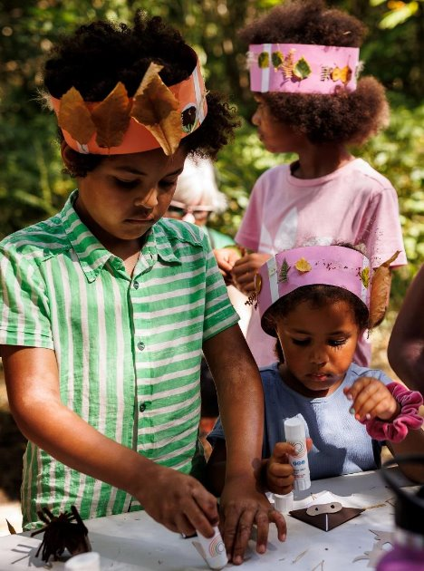
Areas to Consider for Q1
Regenerative Tourism
Champions that tourism should leave a place better than it was before. The main goal is for visitors to have a positive impact in the destination or place they visit. Through this we wish to champion actions of suppliers, staff and local stakeholders in supporting the entrant on their delivery to the visitor.
We are looking for actions that support some or all of the below to a standard that could inspire visitors, suppliers and staff in positive actions:
Climate – actions to decarbonise energy/mobility towards Net Zero
Circular Economy – clear examples of management of suppliers, waste, recycling, sustainable products and efficient use of resources
Biodiversity – actions to protect and restore nature
Place based – respect for local area/communities, tourism that does no harm
Find out more about sustainability: www.visitengland.org/green
Kent Wildlife Trust, Kent © Tom Cawdron/Kent Wildlife Trust Ethical, Responsible and Sustainable Tourism Award Gold, 2024
Notes:
For the 2025/26 Awards Cycle the previous Ethical Responsible and Sustainable Tourism Award has been replaced with the Regenerative Tourism Award.
Ensure that you direct your applicants to the new Regenerative Tourism guide on the VisitEngland Business Advice Hub.
Adopting these principles isn’t just about being on trend or simply good PR – they are fundamental to achieving excellence.
Regenerative tourism issues make sense to any business, reducing your costs, reducing your impact and delivering results, both today and for years to come.
This commitment needs to be embedded within the operation, built into what you do and how you do it, not just a ‘bolt-on’ to tick a box.
As with marketing, tell the full story:
How did you identify an opportunity/need?
How did you develop a solution?
How did you implement the solution and measure the effectiveness?
What was the impact on the business/bottom line?
As well as the more obvious aspects of ‘reduce, reuse, recycle’ you need to be working towards –
Local sourcing, real partnerships with local suppliers
Reduced carbon footprint
Helping guests to adopt new practices after they have left
Embedding your operation into the local community, benefitting from it and giving back to it.
Answers to questions are encouraged to include details of:
Climate – actions to decarbonise energy/mobility towards Net Zero
Circular Economy – clear examples of management of suppliers, waste, recycling, sustainable products and efficient use of resources
Biodiversity – actions to protect and restore nature
Place based – respect for local area/communities, tourism that does no harm

Slide 28
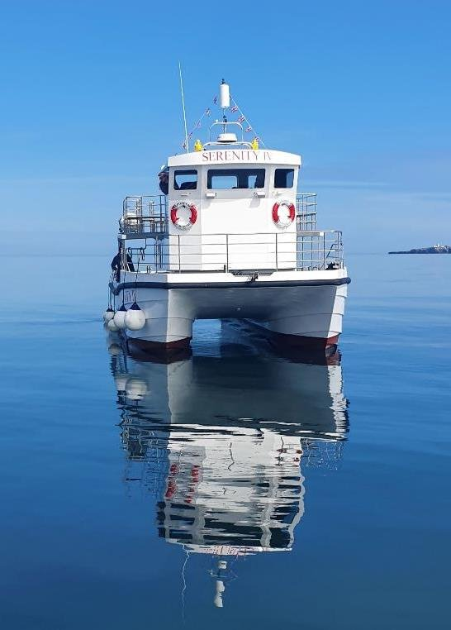
Q2: Your Recent Improvements
Explain your reasons for making the improvements and indicate which parts of the business are impacted:
Promotional initiatives
Improving the skills of you and your team
Expansion, upgrade of facilities, enhancements to your services
Not-for-profit successes
Sustainable practices that align to regenerative tourism
Inclusive facilities, experience and welcome
Innovative adaption, diversification and/ or resilience building
Use of digital technologies
Approximate date of improvement
Serenity Farne Island Boat Tours, Northumberland © Andy Douglas Experience of the Year, Gold, 2024
Notes:
The judges (certainly at a national level) will be looking for what's new, particularly if you have had success in the awards in the past.
Judges will be looking for examples of improvements from across the business.
Only include examples of improvements undertaken in the last two years.
This question is for you to tell us about up to five ways in which you have developed your business and/or improved the customer experience over the last two years.
Promotional initiatives e.g. new website
Improving the skills of you and your team
Expansion, upgrade of facilities, enhancements to your services
Not-for-profit successes e.g. community engagement, membership/ partnership increases
Sustainable practices that align to regenerative tourism
Inclusive facilities, experience and welcome
Innovative adaption, diversification and/ or resilience building
For example, this may include how the venue has adapted to host hybrid events
Use of digital technologies, such as automated services, robotics and artificial intelligence (AI)
It is helpful to provide the reasons for making the improvements e.g. driven by customer feedback and the approximate date of improvement.
Again, show the full journey:
Why did you decide to do it?
How did you decide what to do?
How did you embed sustainability into the plans?
What targets did you set out to achieve?
How have you monitored outcomes and outputs?

Slide 29
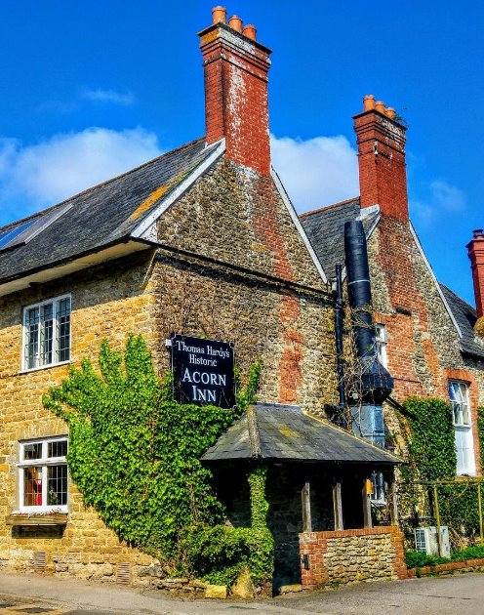
Q3: Your Results
Are you able to attribute success directly to any of the improvements that you’ve made (Question 2)?
Don’t be vague, use figures and specific examples i.e.
% increase in occupancy levels/visitor numbers, sales, customer satisfaction and wastage reduction
% increase in online bookings or repeat business
Business generated from marketing activity
Growth of social media following and engagement
Not-for-profit successes e.g. community engagement, membership/partnership increases
How significant has the impact been on your business?
The Acorn Inn, Dorset © Richard Legg/ The Acorn Inn Pub of the Year, Silver 2024
Notes:
Tell us about three successes from the last year, providing figures where relevant.
Judges will be looking for detailed examples of successes from across the business.
One or more of the following example areas may be relevant to address in your answer (it is not mandatory to cover every area):
Whether you able to attribute success directly to any of the improvements that you’ve made (mentioned in Question 2)
Percentage increase in conversion of enquiries, sales, customer satisfaction and wastage reduction
Increase in repeat business
Business generated from marketing activity
Growth of social media following and engagement
Not-for-profit successes e.g. community engagement, membership/ partnership increases
The significance of the level of impact on your business

Slide 30
Q4: Your Future Plans
Continued innovation, adaption, diversification and/ or resilience building
Sustainable practices that align to regenerative tourism
Inclusive facilities, experience and welcome
Expansion, upgrade of facilities, enhancements to your services
Improving the skills of you and your team
Marketing and PR, including partnerships with other businesses
Operational efficiency
Not-for-profit improvements
Use of digital technologies
Sleepy Owl Devon © Sleepy Owl Devon, Self Catering Accommodation of the Year, Gold, 2024
Notes:
You may be excellent now, but judges are also looking for how the business will continue to evolve – a truly outstanding business never stands still.
Tell us about three ways you will develop and promote your business over the next year and the reasons why. Judges will be looking for detailed examples of future plans from across the business, with a clear rationale.
One or more of the following example areas may be relevant to address in your answer (it is not mandatory to cover every area):
Continued adaption, diversification and resilience building
For example, this may include how the venue will adapt and introduce technical enhancements
Sustainable practices that align to regenerative tourism, this may include:
Climate – actions to decarbonise energy/mobility towards Net Zero
Circular Economy – clear examples of management of suppliers, waste, recycling, sustainable products and efficient use of resources
Biodiversity – actions to protect and restore nature
Place based – respect for local area/communities, use of local suppliers, tourism that does no harm
Inclusive facilities, experience and welcome, this may include:
how you attract a diverse audience
how you provide for visitors with access needs and
what you have in place to ensure all visitors are welcomed; supported and encouraged to take part or enjoy their stay with you
Expansion, upgrade of facilities, enhancements to your services
Improving the skills of you and your team
Marketing and PR, including partnerships with other businesses
Operational efficiency
Not-for-profit improvements e.g. community engagement, membership/ partnership development
Use of digital technologies, such as automated services, robotics and artificial intelligence (AI)

Slide 31
Top tips 2
Refer to the relevant criteria
Make sure you answer the question
Tailor your answer
Use facts - do not make ambiguous or inaccurate claims
Support answers with evidence
Don’t assume the judges know your business!
Use the word limit and give detailed answers
Make every word count - don’t waste word count with duplication
Ensure all aspects of your business are covered
Hoe Grange Holidays, Derbyshire © Hoe Grange Holidays, Accessible and Inclusive Tourism Award, Gold 2024
Notes:
Think of the radio panel show ‘just a minute’ – avoid:
Hesitation (be specific and confident)
Repetition (don’t duplicate)
Deviation (answer the question).
The questions are specific. Once you have drafted your answer, read the question again and challenge yourself to tighten your response.
If you can convey what you need to say in less words than allowed, do not feel the need to pad out your answer, but do make the best use of the word count that’s available to you to show how great you are.
A common mistake is to provide the answer you want to give, rather than answer the question that has been asked.
Be specific, use data and evidenced facts to support your answer.
You can enter multiple categories if they are relevant to your business but do ensure your answers are specific to each category you’re entering, don’t simply copy/paste each time.

Slide 32
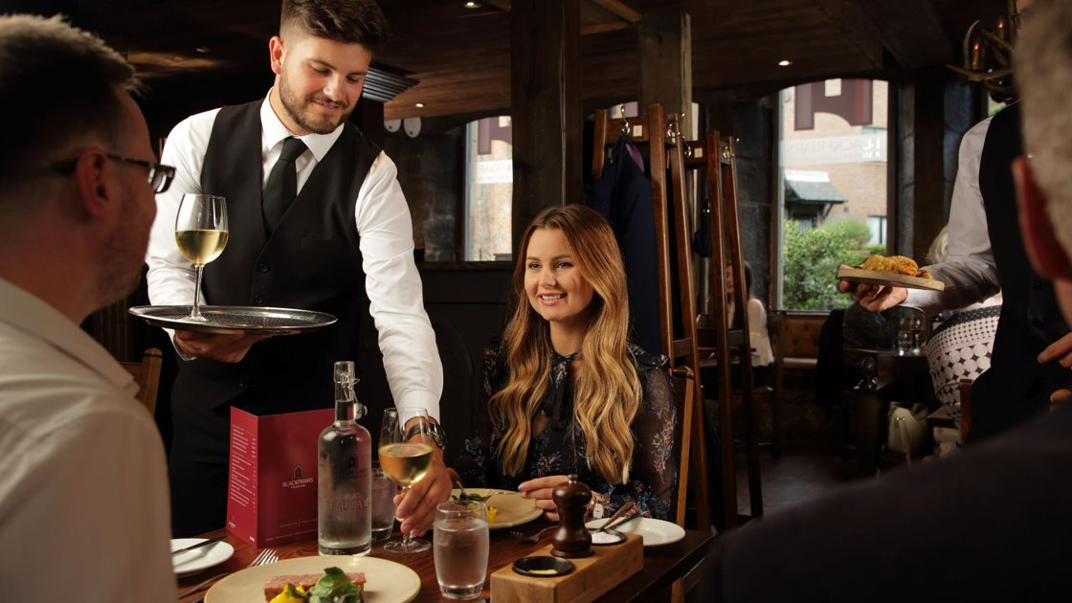
Top tips 3
Start preparation early
Highlight why you are different and what are your best qualities
Don’t over complicate
Reflect your passion and personality
Fully answer question, use prompts to help
Include initiatives from across the business
Show how you act on feedback (and mistakes!)
Don’t forget accessibility and sustainability
Embrace review sites; they can be invaluable
Read through the form twice – ask a colleague
Review and submit on time
Blackfriars Restaurant, Tyne & Wear © Blackfriars Restaurant, Taste of England, Silver, 2024
Notes:
Make your responses category specific – don’t just copy and paste your answers from another category.
Key areas to emphasise in this discussion:
Show your passion for your business
Allow time to prepare and submit early if possible, don’t leave it to the last minute – something unforeseen will always happen!
Remember the judges don’t know your business and can only judge based on the evidence and detail included within your entry.
Consider asking a colleague, employee or friend to review your entry before submitting it; they may well think of qualities & improvements you’ve forgotten
Make sure your photos are inspiring and your business’ best advert

Slide 33
What are your next steps?

Slide 34
Timetable
Date | Activity
01 June 2025 | Awards open
20 July 2025 | Awards deadline
September 2025 | Announcement of finalists
March 2026 | Awards ceremony
June 2026 | VisitEngland Awards for Excellence event
© VisitBritain/Daniela Luquini

Slide 35
Useful links
Benefits of entering visitbritain.org/business-advice/visitengland-awards-excellence#why-apply
The national awards www.visitenglandawards.org
Review the core entry forms in advance of entering visitbritain.org/business-advice/visitengland-awards-excellence/visitengland-awards-excellence-award-categories
Get free business advice visitbritain.org/business-advice
Sign-up to industry newsletter visitbritain.org/subscribe-our-newsletters
Download free toolkits: Award Winner’s PR Toolkit visitbritain.org/business-advice/visitengland-awards-excellence#pr-toolkit
Digital Marketing Toolkit www.visitengland.org/onlinemarketing
Accessible & Inclusive Tourism Toolkit www.visitbritain.org/business-advice/make-your-business-accessible-and-inclusive/visitengland-accessible-and-inclusive
Watch webinar on accessibility www.visitbritain.org/business-advice/business-recovery-webinars
Watch webinar on sustainability www.visitbritain.org/business-advice/business-recovery-webinars
Improve your sustainability www.visitengland.org/green
Start your entry here: https://visitpeakdistrict.com/industry/events/category/tourism-awards
Notes:
Here are all the links that we have talked about today, but as I said at the start, we will be emailing them to you so you can view them at your leisure. They all contain loads of useful information that will help you be the best at what you do. If you haven’t yet signed up to the VisitEngland industry e-newsletter, I recommend that you do, as it contains loads of useful information such as the latest international market intelligence, partnership marketing opportunities, tourism events and news.

Slide 36
And remember . . .

Slide 37
Excellence pays!
Notes:
You will be a much better business and far more attractive to visitors, guests and future employees having undertaken the process of entering the awards, regardless of whether you win a category this year. Embrace the process as a business growth/development opportunity and use it to move closer to achieving excellence.
The benefits will be many

Slide 38
Useful information
Before you start your application:
Read and accept the Applicant Terms and Conditions when prompted.
Make sure that you are eligible for the category you are considering applying for. Read the eligibility criteria carefully, if you are deemed ineligible you may be moved to another category where you would be eligible, or your application may be discounted altogether. If you are not sure whether you are eligible, check with the competition organiser before completing your application.
To avoid duplication in your responses, read all the questions before you start. For most categories each question covers a different aspect of your business, e.g.
Question 1 – Top Qualities e.g. unique selling points, strengths and the essence of the business
Question 2 – Recent Improvements e.g. business developments and improvements over the last two years
Question 3 – Results e.g. recent successes from across the business – providing figures where relevant
Question 4 – Future Plans e.g. plans to develop and promote the business over the next year
Notes:
To end, here’s a summary of the best advice that will help you to submit a successful entry

Slide 39
Useful information
Before you start your application:
Read the guidance information starting ‘judges will be looking for . . .’ for suggestions on what to include in your answers.
By setting up an account you can save your work and come back to it later – you don’t have to start and submit your application in one sitting.
Take your time but be mindful of the closing date for applications.
Be aware of the word limits, they are exact.
Proof your entry before submitting.
Good luck!

Slide 40
Any questions?
Lindsay Rae
lindsay.rae@visitpeakdistrict.com
07711 302151
#PDDAwards #VEAwards2025

